Slide 1
Natural Disaster Tweet
How to use tweets as information source during natural disasters?
Joséphine Bach, Lucas Goumard, Mathilde Deschaud, Martin Perraudin

Slide 2
Objective: Helping first-responders identifying actionable tweets during natural disasters spikes
x10
increase in number of natural disasters since 1900
#1
Twitter social media used in emergency times
Challenge:
Reliable detection of actionable tweets
Sources: EM-DAT (2019), Setiaman, Sobur. (2023). Re: Which social media is most used in natural disasters? 911-LeWagon team

Slide 3
We collected nearly 250,000 tweets from 2 datasets
1
Our project
A
B
Identify disasters-related tweets vs random topics
Recognize actionable tweets & share them with first responders
Actionable
Non-disaster
Disaster
Informative, kindness…
124k randomly selected tweets
124k disaster related tweets
124,158 disaster-related tweets
40% of those are labeled actionable, from CrisisNLP
Sources: CrisisNLP, 911-LeWagon team
Notes:
Originally, we had 70/30 as a split, because of our model results we managed to adjust the split to 60 /40 (increasing Actionable, reducing Informative)

Slide 4




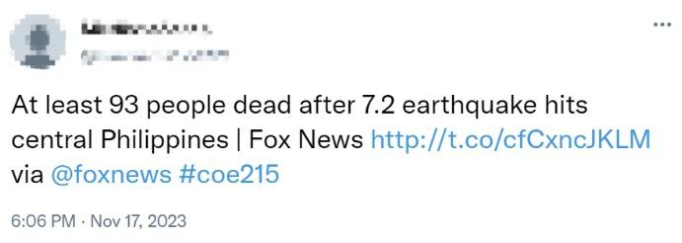
Key steps in our data preprocessing function
2
Raw data
Cleaning function
Tokenizing
Padding &
Splitting
Example
least people dead earthquake hit central philippine fox news httptcocfcxncjklm via
[[5], [1], [3], [11], [2], [4], [1], [10], [4], [5], [1], [12], [1], [3], [12], [3]]
array([[ 5., 1., 3.,...,11.,0.],
[ 1., 0., 0., ...,0.,0.],
[ 3., 0., 0.,...,20.,0.],
… ], dtype=float32)

Slide 5
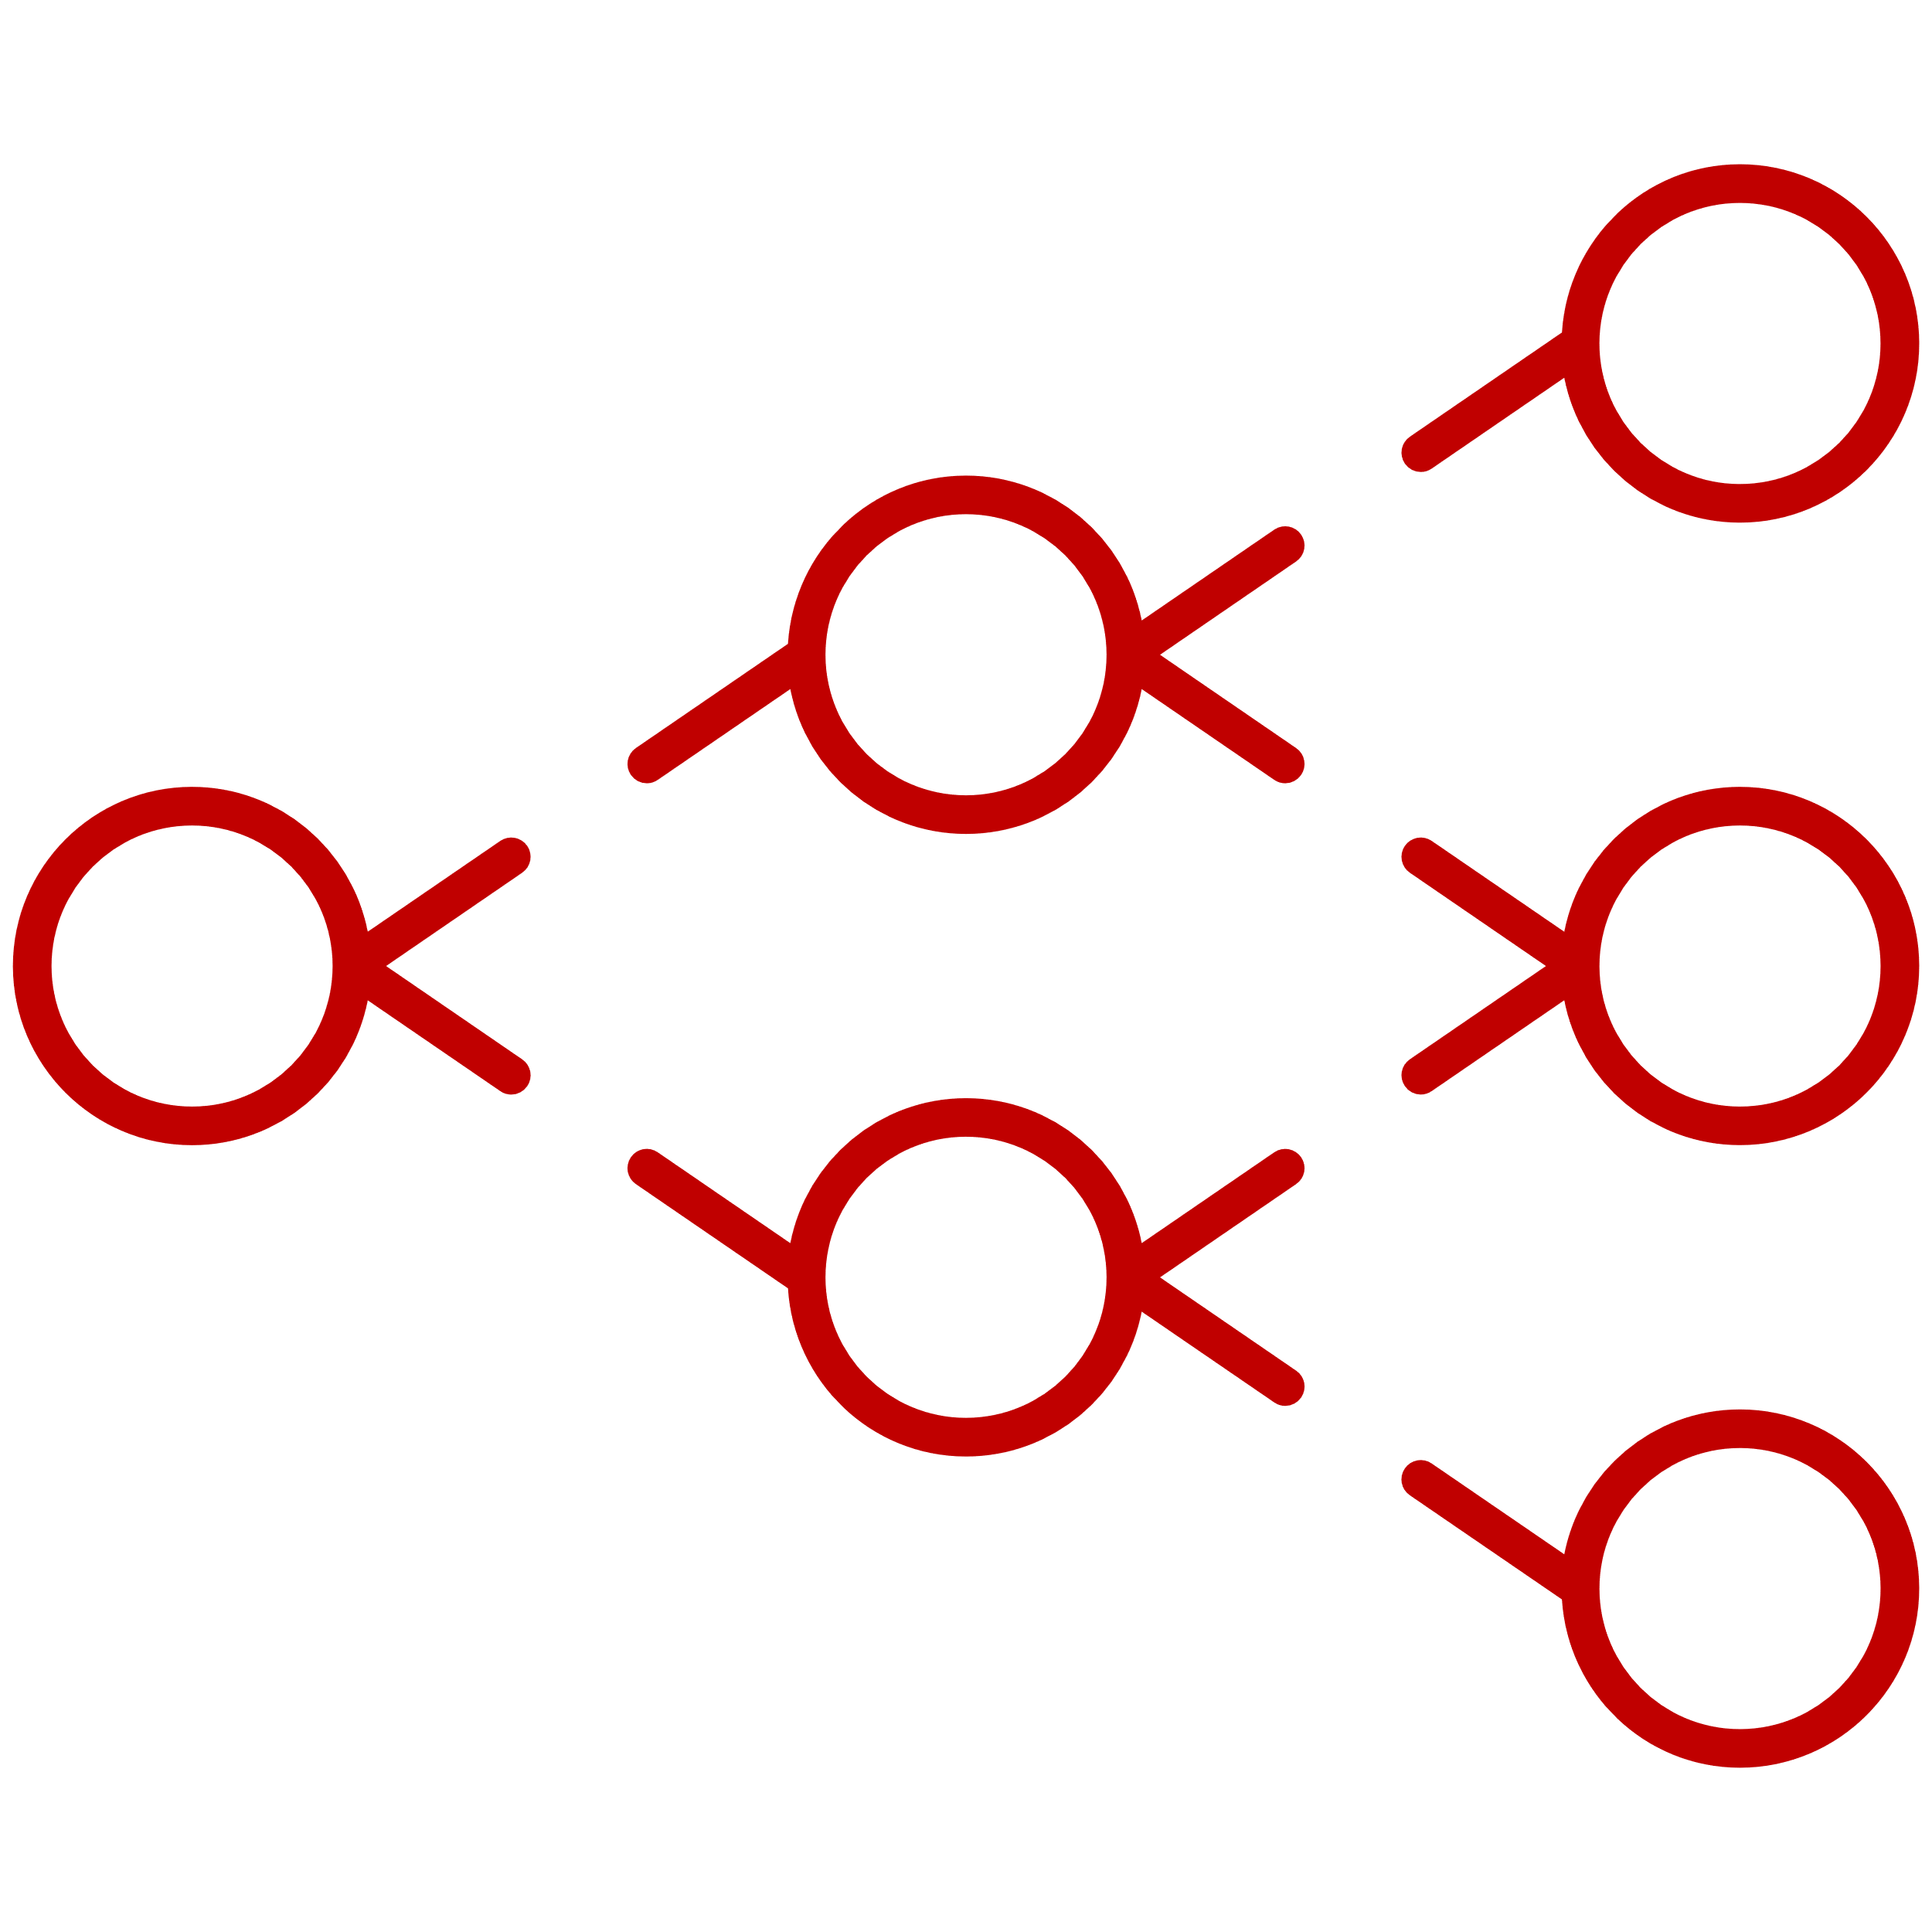


Over 50 different models, split in 3 categories to select the best-performing one
3
Machine Learning
Deep Learning
Naive-Bayes
Recurrent Neural Networks
Convolutional Neural Networks
Sources: Internal analysis

Slide 6
Naive-Bayes: Step 1 - Machine Learning trial
3
Machine Learning
Deep Learning
Naive-Bayes
Recurrent Neural Networks
Convolutional Neural Networks
Trains quickly
Performs well on two-classes problems
Doesn’t take the context and relationship between words into account
Benefits
Negatives
Precision
A
Disaster detection
xx%
Actionability detection
xx%
B
Sources: Internal analysis

Slide 7
RNN: Step 2 - Start of our Deep Learning trials
3
Machine Learning
Deep Learning
Naive-Bayes
Recurrent Neural Networks
Convolutional Neural Networks
Saves sentences’ context
filters out irrelevant tokens
Doesn’t take the context and relationship between words into account
Benefits
Negatives
Precision - LSTM
Precision - GRU
A
Disaster detection
xx%
xx%
Actionability detection
xx%
xx%
B
Sources: Internal analysis
Notes:
GRU-specific: less complex than LSTM, requires less computation & therefore well-adapted to tweets (short to moderate text length)

Slide 8
CNN: Step 3 - final trials on other DL models
3
Machine Learning
Deep Learning
Naive-Bayes
Recurrent Neural Networks
Convolutional Neural Networks
Faster than RNNs
Great at identifying patterns in text
Initially not adapted this type of task
Benefits
Negatives
Precision
A
Disaster detection
xx%
Actionability detection
xx%
B
Sources: Internal analysis

Slide 9
Our rationale for model selection – Using precision metrics
3
Machine Learning
Deep Learning
Naive-Bayes
Recurrent Neural Networks
Convolutional Neural Networks
LSTM
GRU
A
Disaster detection
XX%
XX%
XX%
XX%
B
Actionability detection
XX%
XX%
XX%
XX%
Sources: Internal analysis

Slide 10
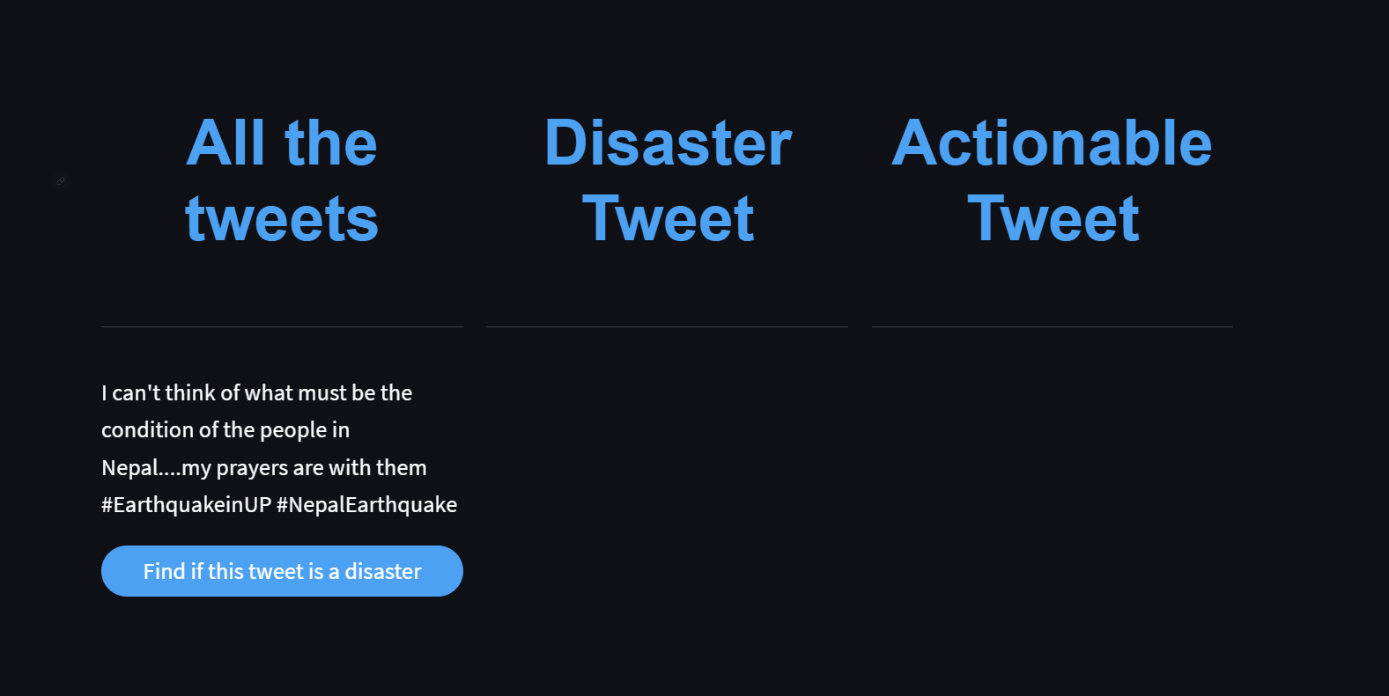
We built an API that uses this model to predict if a tweet is related to natural disaster & if it is actionable
4

Slide 11




Challenges Encountered and Pathways Forward: A Reflection and Outlook
5
Troubles
&
Solutions
Data splitting
Deal with data balance
Fine tuning
Complexity vs simplicity
Go
Further
Extract more information
for new application fields
Location
Profile

Slide 12
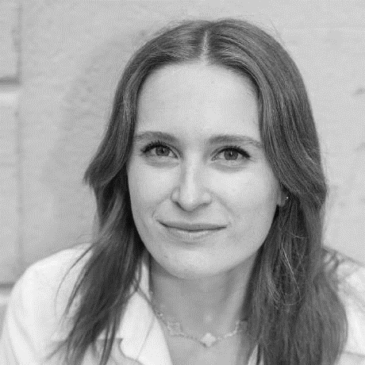



Thank you!
Joséphine
BACH
Mathilde
DESCHAUD
Martin
PERRAUDIN
Lucas
GOUMARD

